Slide 1
LECTURE 5:
DEVIANCE AND SOCIAL CONTROL

Slide 2
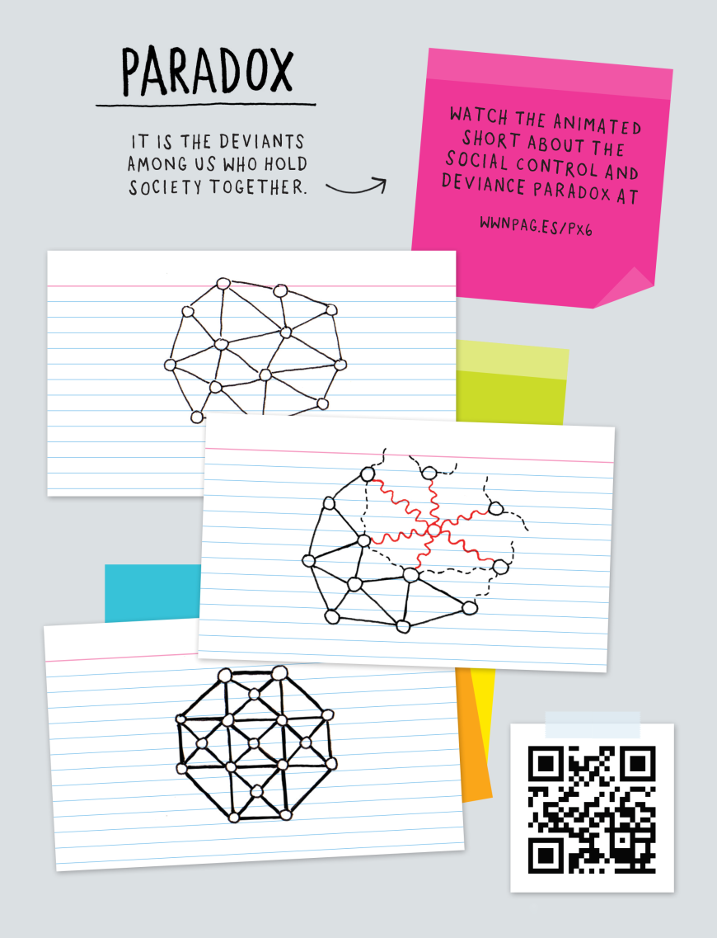
Paradox
Paradox: It is the deviants among us who hold society together.
Click here to see the Paradox Animation:
http://wwnpag.es/PX6

Slide 3
Questions to think about
What is deviance? – to answer this we have to ask “what is normal?” …what are the socially constructed group boundaries and social norms? Where do these come from?
How is social control imposed on society? What leads (or forces or coerces) people to conform?
How is moral behavior defined and regulated? Why is some behavior considered good(moral) and bad (immoral)? Why is some deviance the subject of moral panic while others are not?
How do power and inequality impact deviance? How do those in power enforce their own definitions of deviance? How are those without power more likely to be labeled as deviants?

Slide 4
Topics
1. What is social deviance?
2. Structural functionalist approach to social deviance
3. Symbolic interactionist approach to social deviance
4. Social conflict approach to deviance

Slide 5
Defining Social Deviance
Textbook definition
  Social Deviance: any transgression of socially established norms
    Very broad definition that is rather vague, incomplete
There are, however, may ways to conceptualize social deviance
  Different theories of deviance will assume different conceptions of deviance.

Slide 6
Defining Social Deviance
Normative conception of deviance:
  assumes that there is a general set of norms of behavior, conduct, and conditions for which we can agree.
  Deviance = violation of a rule (norm, law) agreed upon by the majority of a particular social group/society
  Mostly used by structural-functionalists

Slide 7
Defining Social Deviance
Social Constructionist (Reactionary) conception of deviance:
  Assumes that the definition of deviance is constructed based on the interactions of those in society
    Behaviors or beliefs are not inherently deviant … they are only deviant once they are labeled and treated as deviant
  Deviance = the behaviors or beliefs that illicit a label of deviance
  Mostly used by symbolic interactionists (but also by social conflict approach when discussing power as a integral part of the construction process)

Slide 8
Defining Social Deviance
Social Constructionist conception of deviance: (continued)
  “Social groups create deviance by making rules whose infraction constitutes deviance, and by applying those rules to particular people and labeling them as outsiders. For this point of view, deviance is not a quality of the act the person commits but rather a consequence of the application by others of rules and sanctions to an ‘offender’. The deviant is one to whom the label has successfully been applied; deviant behaviors is behavior that people so label.” (Becker, 1973, p. 9)

Slide 9
Defining Social Deviance
Critical conception of deviance:
  Assumes that what is considered “normal” is established by those in power to maintain and enhance their power
  Deviance = whatever goes against the interests of those in power and is therefore defined by those in power as deviant
  Mostly used by social conflict theorists

Slide 10
Defining Social Deviance
Critical conception of deviance: (continued)
  Explores the relationship between power and deviance
      Power is connected to our basic assumptions about what’s normal and what’s deviant.
      Power determines whether and how authorities enforce norms and punish deviance.
      Access to power enables some privileged groups to engage in distinct forms of deviant behavior.
      Power allows some people to escape being branded or punished as deviant.

Slide 11
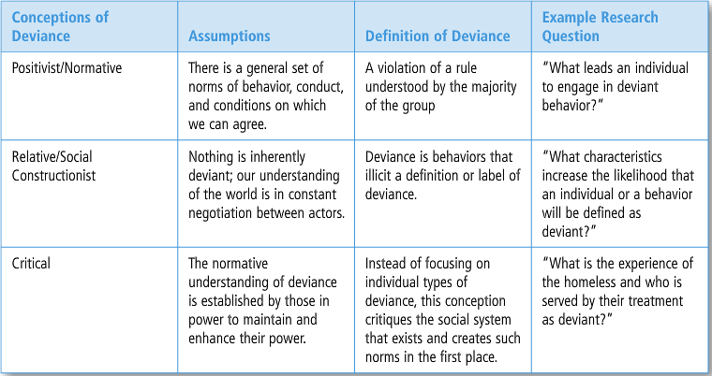
Defining Social Deviance
3 possible conceptions of “social deviance”

Slide 12
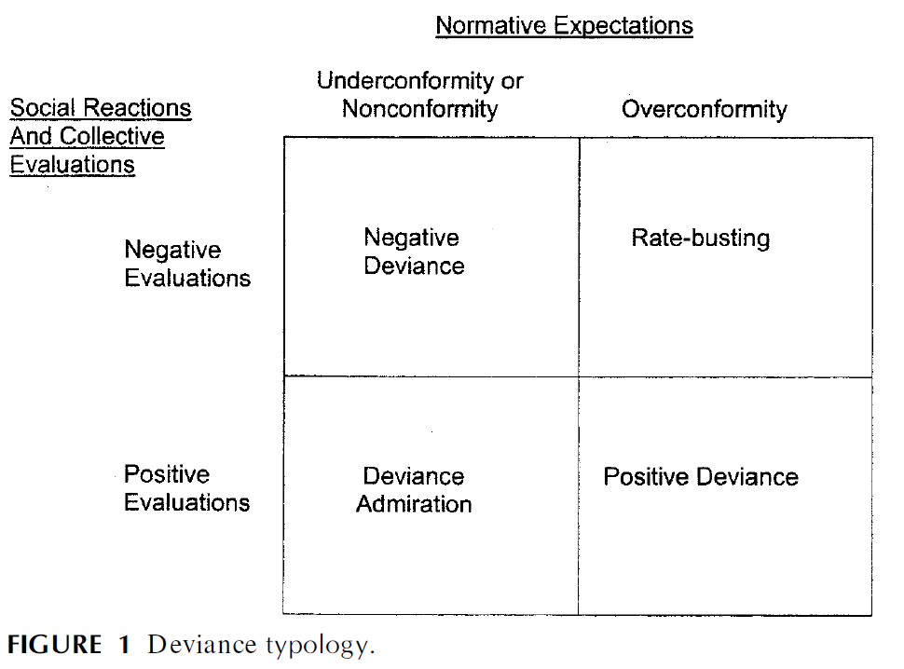

Slide 13
Defining Deviance
How is social deviance different from crime?
  Each are socially defined by particular societies at particular times
    Crime: the violation of laws enacted by society
  While there is some overlap … Not all deviance is criminal AND not all crime is considered deviance… Examples????

Slide 14
Defining Deviance
Social Control: the incentives and punishments that promote conformity in social life
  the efforts to ensure conformity to a norm, rule, or law
  attempts by society to regulate people’s thoughts and behavior
  processes by which people define and respond to deviant behavior
  can be voluntary (internalized norms) or involuntary (crime and punishment)
Deviance: calls forth efforts of social control.

Slide 15
Defining Deviance
Social Control: (continued)
Agents of social control:
  the social institutions that enforce norms and rules, attempt to prevent rule violations, and identify and punish rule violators
  Can be same people/institutions as “agents of socialization”
Social Control theory:
  our behavior is regulated by the strength of our connection to major social institutions, including family, school, and religion

Slide 16
Defining Deviance
Social Control: (continued)
Types of Social Control: Internal vs. External
  1.) Internal social control
      Operates through socialization processes
  2.) External social control
      Operates through a system of rewards and punishments called sanctions.

Slide 17
Defining Deviance
Social Control: (continued)
Types of Social Control: Informal vs. Formal
  1.) Informal Social Control
    Ex: shunning, criticizing, etc.
  2.) Formal Social Control
    Law enforcement
  3.) Semi-formal Social Control
    Non-criminal, bureaucratic social control

Slide 18
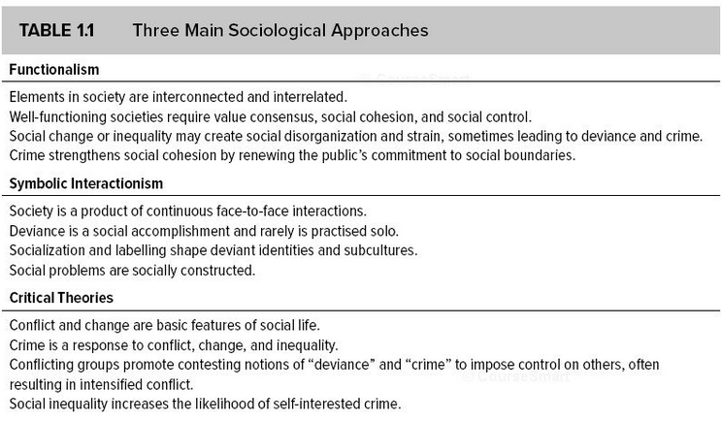
Sociological Perspectives on Deviance

Slide 19
Topics
1. What is social deviance?
2. Structural functionalist approach to social deviance
3. Symbolic interactionist approach to social deviance
4. Social conflict approach to deviance

Slide 20
Structural-Functionalist Perspective
Durkheim: studied the ways society holds itself together
  Collective conscience: the shared norms, beliefs, and values in a community
    It is revealed when people engage in deviant behavior
  Social cohesion: the way people form social bonds, relate to each other, and get along on a day-to-day basis.

Slide 21
Structural-Functionalist Perspective
Durkheim: (continued)
  Social cohesion is achieved in two main ways:
    Mechanical solidarity: characteristic of pre-modern societies
      Social cohesion based on the reliable similarity between members of a society; unity is based on shared values and norms and similar functions of all members of society
    Organic solidarity: characteristic of modern societies
      Social cohesion based on interdependence, because the members all perform different specialized functions; society functions like a complex biological organism

Slide 22
Structural-Functionalist Perspective
Durkheim: (continued)
  When individuals engage in deviance, they offend the collective conscience
    The shift from mechanical to organic solidarity signifies a decline in the importance of the collective conscience as well as a shift in the type of social control used to deal with deviance that may threaten the social order
      A shift from repressive law (punitive punishment) to restitutive law (rehabilitative punishment) generally signals this decline in the power of the collective conscience.

Slide 23
Structural-Functionalist Perspective
Durkheim: (continued)
  repressive law: characteristic of mechanical solidarity, where offenders are likely to be severely punished for any action seen as an offense against the collective conscience
  restitutive law: characteristic of organic solidarity, where offenders are asked to comply with the law or to repay (make restitution) those who have been harmed by their actions

Slide 24
Structural-Functionalist Perspective
Durkheim: (continued)
  While the US is a “modern society”, it is marked by both mechanical and organic forms of social control
    mechanical/repressive law/punitive punishment:
      Ex:
    organic/restitutive law/rehabilitative punishment:
      Ex:

Slide 25
Structural-Functionalist Perspective
Durkheim: (continued)
  Deviance is NECESSARY in all societies and has a number of FUNCTIONS:
    It affirms cultural values and norms.
    Clarifies moral boundaries.
    Brings people together when they respond to deviance.
    Encourages social change – reflects will of people
    Acts as a safety-valve – expression of discontent
    Acts as a warning device – indicates malfunctioning part(s)

Slide 26
Structural-Functionalist Perspective
Durkheim: (continued)
  Without clear social norms and values, anomie occurs
  Anomie—a state of social strain, normative confusion, or rapid change in norms, when people’s behavior is no longer restrained by conventional norms
      Leads to increased suicide and crime rates

Slide 27
Structural-Functionalism:
Merton’s Strain Theory
Ex: Strain Theory (Robert K. Merton)
  strain can lead to deviant behavior/beliefs
    Assumes consensus in terms of cultural goals, aspirations, expectations
  strain occurs when there is a disjunction between culturally defined goals and structurally available opportunities (institutionalized means)
    Deviance involves normal adaptions to these various societal conditions
Notes:
*

Slide 28
Structural Functionalism:
Merton’s Strain theory
Conformity: accept the cultural goals and accept the institutionalized means to achieve those goals
Ritualism: reject the cultural goals but accept the institutionalized means to achieve those goals; going through the motions while rejecting culturally-valued goals
Innovation: accept the cultural goals but reject the institutionalized means to achieve those goals; socially unacceptable routes to success
Retreatism: reject the cultural goals and reject the institutionalized means to achieve those goals; isolation and withdrawal when without access to the means of success and rejecting goals
  Rebellion: creation of new goals and adoption of new means of attaining them

Slide 29
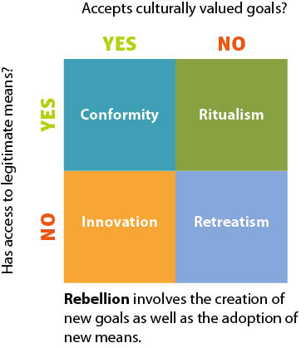
Structural Functionalism:
Merton’s Strain Theory

Slide 30
Structural-Functionalist Perspective:
Merton’s Strain Theory
Application of Anomie Theory: How would anomie theory explain the following?
  Ex: Relationship between Unemployment Rate and Crime Rate
  Ex: drug addicts … why do people abuse drugs? – does this theory adequately explain ALL types of drug addicts or just the stereotype?
  Ex: gangs … why do people join gangs?
  Ex: High crime rates in the United States (compared to other industrialized nations) …Why?
  What groups or persons in society would be considered rebels under this typology?

Slide 31
Topics
1. What is social deviance?
2. Structural functionalist approach to social deviance
3. Symbolic interactionist approach to social deviance
4. Social conflict approach to deviance

Slide 32
Symbolic Interactionist Perspective: Labeling Theory
Labeling Theory:
  Main assumption: people are stigmatized by social labels … these labels become part of their identity.
    Once a labeled individual internalizes their label, they may seek out others who have been similarly labeled to find acceptance and to avoid stigma
    A person labeled a delinquent or criminal will associate with others delinquents/criminals … leading to delinquent/criminal behavior
    Erickson: “Deviance is not a property inherent in any particular kind of behavior; it is a property conferred upon that behavior” (1966).

Slide 33
Symbolic Interactionist Perspective: Labeling Theory
Labeling Theory:
  Labeling leads to further deviance because it:
    1. affects one’s identity
    2. affects how other’s treat and react toward a labeled individual and/or a particular behavior
      Leads to social rejection and withdrawal from conventional society
    3. leads to interaction in subcultures of deviance
      Increases opportunities to engage in deviance behavior

Slide 34
Symbolic Interactionist Perspective: Labeling Theory
The Effects of Deviant Labels
  Stigma: the shame attached to a behavior or status that is considered socially unacceptable or discrediting
    greatly changes a person’s self-concept and social identity
    Operates as a master status.
    Based on behavior or visible cues
    Stigma can remain after behavior has disappeared
  Secondary deviance: deviant behavior that is a response to the negative consequences of labeling

Slide 35
Symbolic-Interaction and Labeling
Tannenbaum (1938) “Crime and Community” – secondary deviance
  Punishment doesn’t always curb delinquent behavior
    it can encourage deviant behavior through the process and effects of labeling
    In contrast to Strain Theory, this implies that crime could cause strain such as unemployment (rather than the other way around)

Slide 36
Symbolic-Interaction and Labeling
Looking glass self: the self-image an individual forms by imagining what others think of his or her behavior and appearance
  If someone is labeled or treated like a deviant, they may begin to see them selves as a deviant
Self-fulfilling prophecy: insofar as an individual internalizes this label and alters their self-concept to that of a criminal identity, the individual becomes more likely to continue to act out that label (i.e. engage in more criminal behavior)

Slide 37
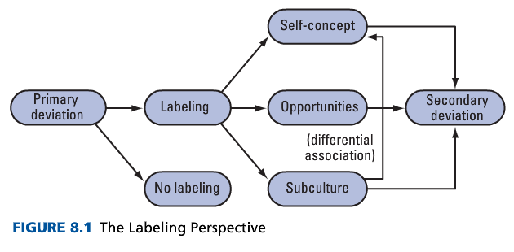
Symbolic-Interaction and Labeling

Slide 38
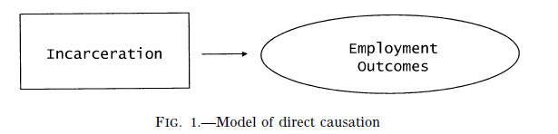
Mark of a Criminal Record
COULD THIS BE A SPURIOUS CORRELATION?
HOW WOULD WE TEST TO SEE IF INCARCERATION ITSELF HAS A DIRECT IMPACT ON EMPLOYMENT OUTCOMES?

Slide 39
Application: Symbolic-Interaction and Labeling Theory
The Mark of a Criminal Record (2003)
Research Questions:
  1. Do employers use information about criminal histories to make hiring decisions and to what extent?
  2. To what extent does race continue to serve as a major barrier to employment?
  3. Is the effect of a criminal record different for black and white applicants?

Slide 40
Mark of a Criminal Record

Slide 41
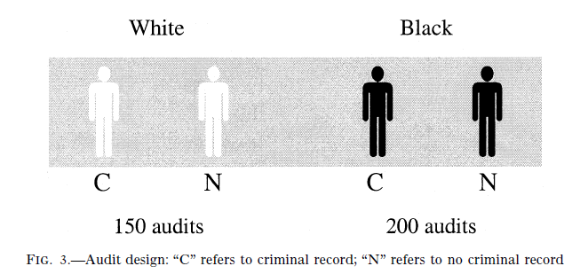
Mark of a Criminal Record

Slide 42
Mark of a Criminal Record
Study Design:
  Uses four male auditors (testers)…two black, two white.
  Testers paired by race, and matched on other characteristics such as appearance and self-presentation style.
  Audit pairs were randomly assigned 15 job openings a week for entry level jobs requiring no previous experience and no education greater than high school
  The white pair and the black pair were assigned separate sets of jobs, with the same-race testers applying for the same jobs
  A total of 350 employers were audited during the course of the study:150 by white pair and 200 by black pair. Additional tests were performed for the black pair because they received fewer callbacks on average

Slide 43
Mark of a Criminal Record
The primary dependent variable = the proportion of applications that elicited callbacks from employers
  Hypothesis: The mark of a criminal record on a job application should decrease the number of callbacks from employers
Criminal record was a drug offense and prison time rather than a violent offense
Testers are assigned favorable work histories prior to incarceration

Slide 44
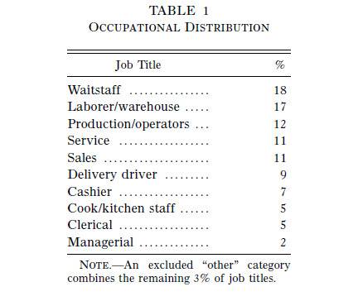
Jobs applied for:

Slide 45
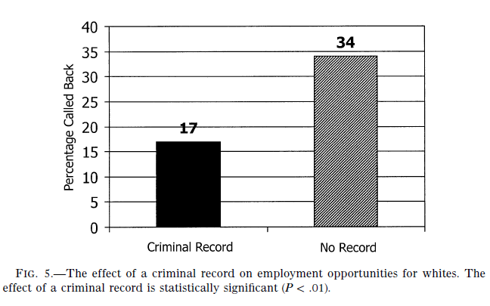
Mark of a Criminal Record

Slide 46
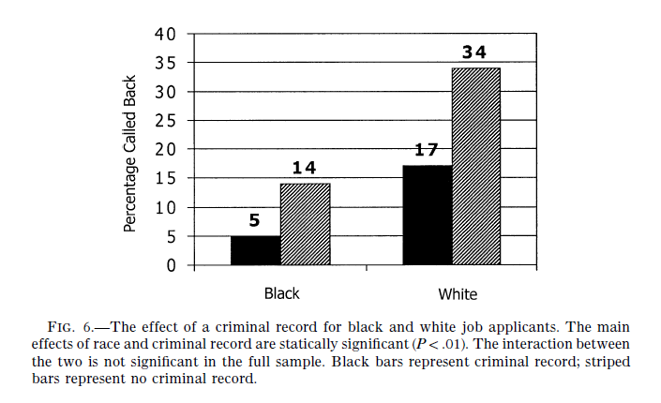
Mark of a Criminal Record

Slide 47
Mark of a Criminal Record
The Effect of a Criminal Record for Whites
  Criminal record has a significant negative effect on likelihood of call back
The Effect of Race
  In general, race shows an effect such that whites get more callbacks regardless of criminal record
Racial Differences in the effects of a criminal record
  The effect of a criminal record is 40% larger for blacks than for whites

Slide 48
Application: Symbolic-Interaction and Labeling Theory
The likelihood of being labeled may also depend on societal stereotypes of certain social groups according to race, gender, and class.
  A form of societal labeling:
    Certain social groups are stereotyped as being prone to engage in deviant/criminal behavior more than others
      Can be an effect of explicit or implicit bias
    Can exacerbate the labeling process

Slide 49
Application: Symbolic-Interaction and Labeling Theory
Other Applications of Labeling Theory:
  How would you apply labeling theory to the experience of ex-convicts once they re-enter and attempt to adjust to life outside of prison?
    Why does the US have such high recidivism rates?
  Rosenhan’s experiment on the power of a label of mental illness: “Being sane in insane places”
    How might the label of mental illness be harmful rather than helpful?
  Sex offender registry laws

Slide 50
Topics
1. What is social deviance?
2. Structural functionalist approach to social deviance
3. Symbolic interactionist approach to social deviance
4. Social conflict approach to deviance

Slide 51
Social Conflict Theories of Deviance
Concerned with:
  the making of rules, especially laws
  why is other, possibly more damaging behavior not outlawed or reacted to as strongly as other behaviors (e.g. cigarettes and alcohol vs. marijuana) (corporate crime v. street crime)
  issues of power in the formation and enforcement of law and social norms
  Also interested in positivist-type questions – how conflict and domination can lead to the enactment of deviant/criminal behavior

Slide 52
Social Conflict Theories of Deviance
Main assumption: the social structure and institutions that make up society affect how we label and treat delinquent/criminal offenders
  Rather than explaining criminal behavior in terms of socialization into attitudes, values, beliefs, and behaviors that deviate from some underlying cultural consensus, social conflict theories argue that the legal system is itself only reflective of the interests of those with power
    In turn, those without economic, political, and/or social power are more likely to be labeled and treated as criminals
      AND, their behaviors are more likely to be criminalized

Slide 53
Social Conflict Theories of Deviance
In The Social Reality of Crime, Richard Quinney builds upon Marx’s ideas about the elite using the legal system to control those without power.
  They do so by defining certain acts as criminal and using the criminal justice system to keep people from gaining access to their resources.
  Because they control the system, as well as the media, the elite can control not only who becomes a criminal, and what their punishment and long-term future consist of, but also the public’s perceptions of crime

Slide 54
Social Conflict Theories of Deviance
In other words, the most powerful in society define the Social Reality of Crime by:
  defining some behavior as criminal that threatens its interests
  applying law to protect its interests
  constructing and diffusing an ideology of crime, which inevitably criminalizes the powerless
    Defines behavior of the dominant class as normal (regardless of potential harm or benefit to society)

Slide 55
Social Conflict Theories of Deviance
Ex: The New Jim Crow: Mass Incarceration in an Age of Colorblindness (Michelle Alexander)
Arguments:
  Disproportionate number of African Americans are under the control of the criminal justice system today
  Discrimination in housing, education, employment, and voting rights, which many Americans thought was wiped out by the civil rights laws of the 1960s, is now perfectly legal against anyone labeled a “felon.”
  Since many more people of color than whites are made felons by the entire system of mass incarceration, racial discrimination remains as powerful as it was under slavery or under the post-slavery era of Jim Crow segregation.

Slide 56
Social Conflict Theory: Application
Analysis of law and democracy can reveal the shortcomings of realizing democratic ideals in law and the power dimension of law
Ex: felony disenfranchisement laws (Manza and Uggen 2006)
  Related to redistricting or ‘gerrymandering’
  Prison-based gerrymandering
    In most states, census residence rules require that incarcerated people be counted at their place of incarceration as opposed to their home address.
    But, incarcerated people cannot vote – so this boosts the votes of residents in districts with prisons (mostly rural and white) and takes away voting power of incarcerated persons’ communities (largely urban and/or minority communities)

Slide 57
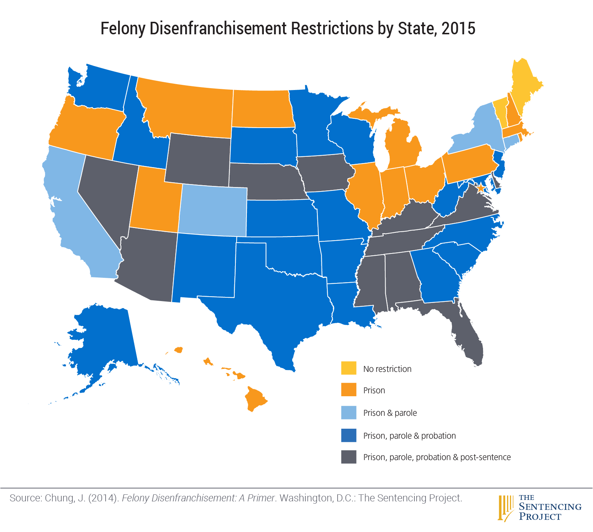
Social Conflict Theory: Application

Slide 58
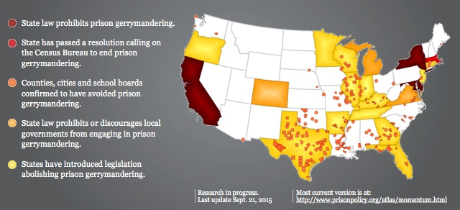
Social Conflict Theory: Application
https://www.prisonersofthecensus.org/50states/

